Slide 1
Vocabulary
Cap. 1a

Slide 2
bailar
to dance

Slide 3
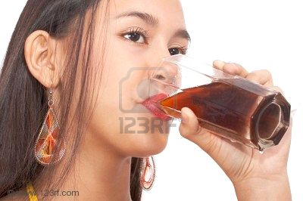
Beber refrescos
to drink refreshments

Slide 4
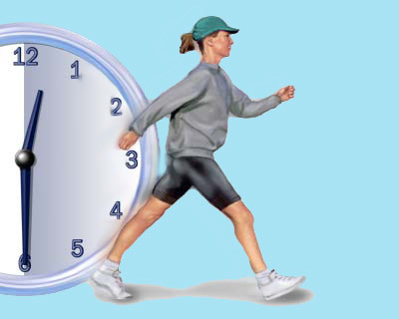
caminar
to walk

Slide 5
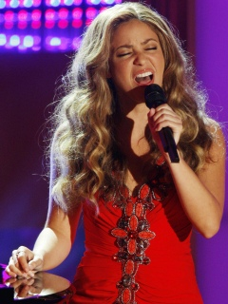
cantar
to sing

Slide 6
cazar
to hunt

Slide 7
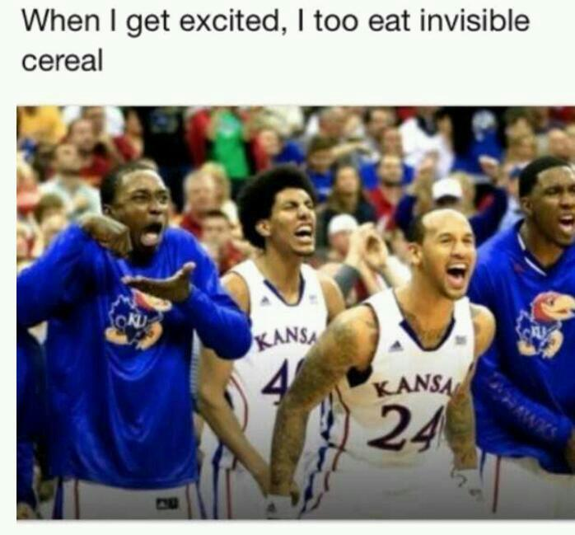
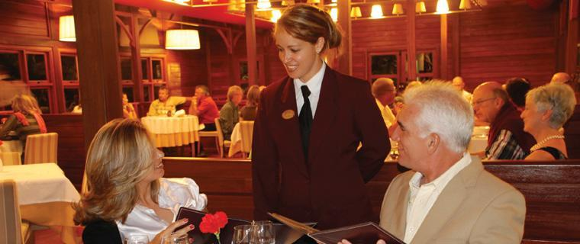
Comer en restaurantes
to eat in restaurants

Slide 8
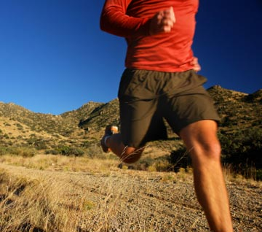
correr
to run

Slide 9
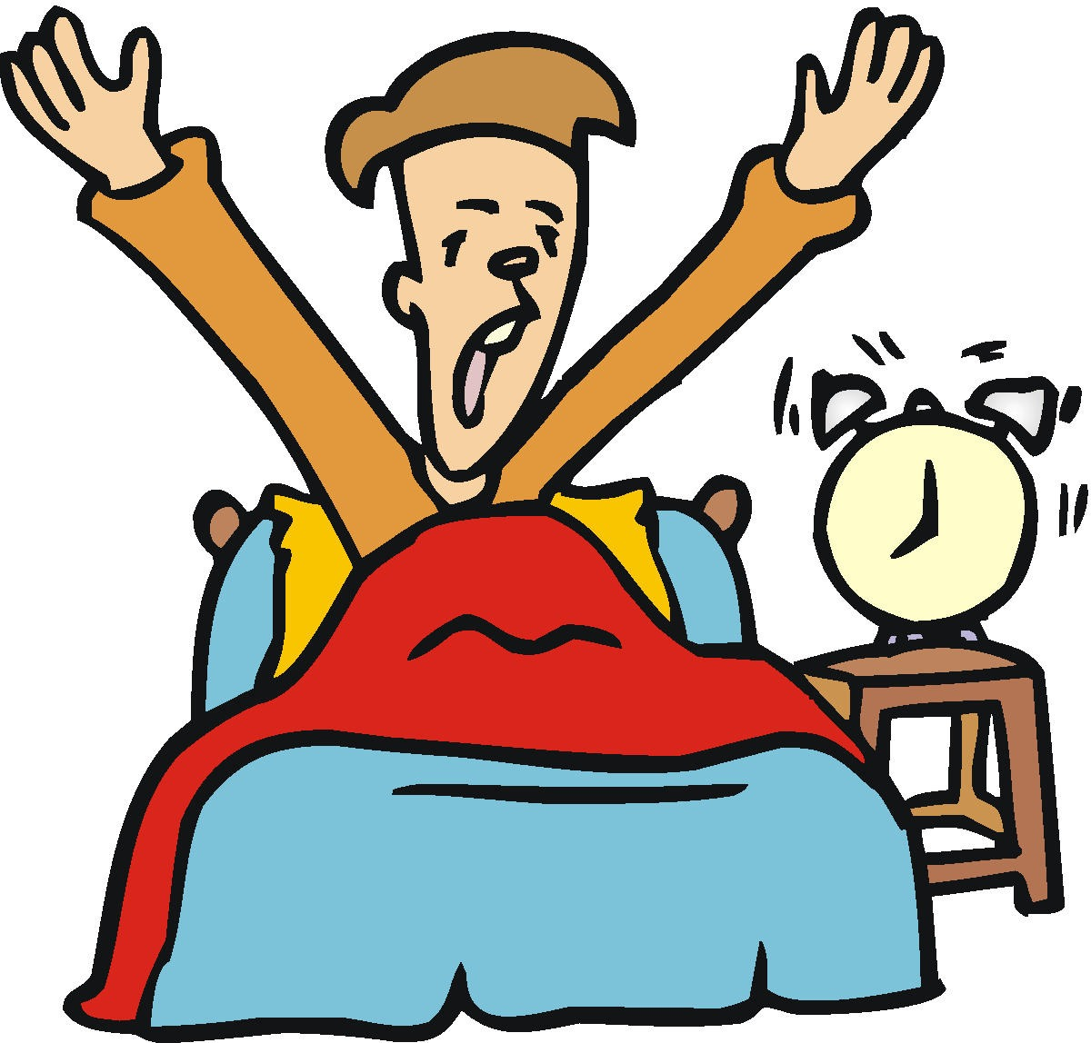
despertar
to wake up

Slide 10

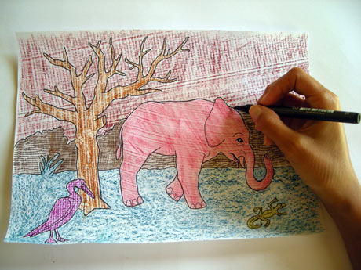
dibujar
to draw

Slide 11
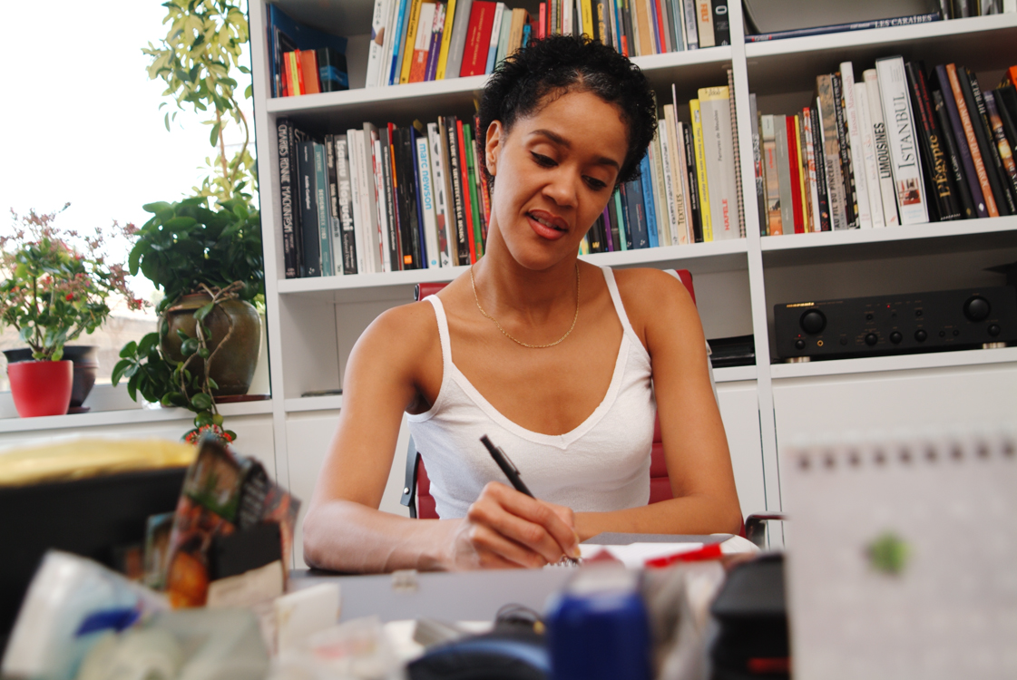
Escribir cuentos, poesia
to write
stories/poetry

Slide 12
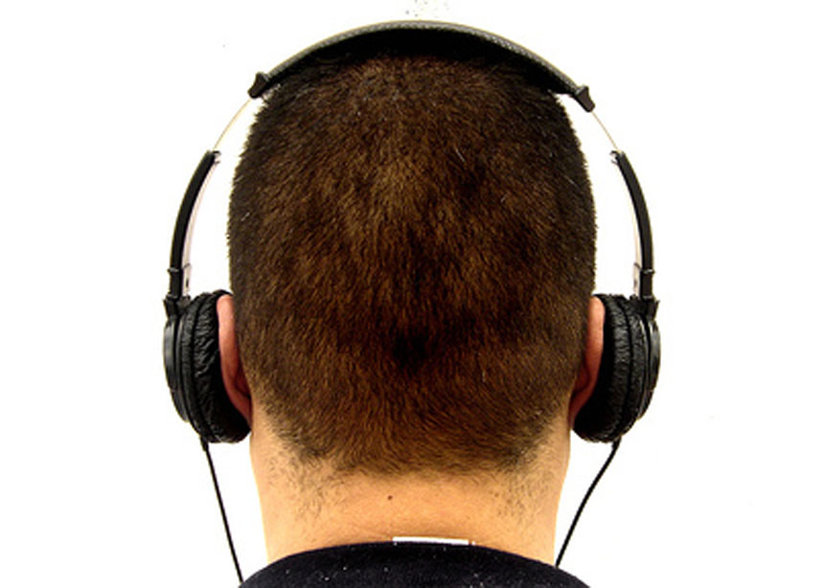
escuchar música
to listen to music

Slide 13
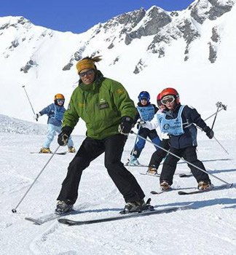
esquiar
to ski

Slide 14
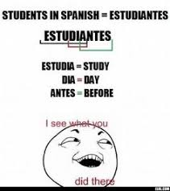

estudiar
to study

Slide 15
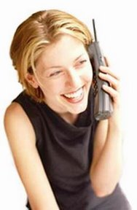
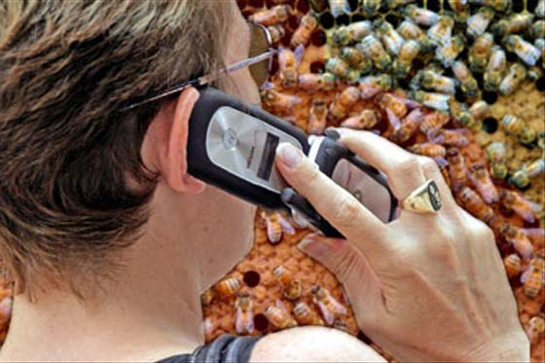
hablar por teléfono/movil
to talk on the phone/cell phone

Slide 16
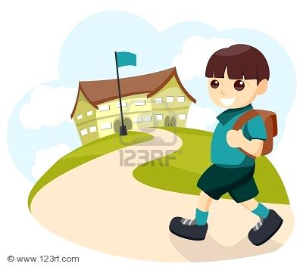
ir a la escuela
to go to school

Slide 17
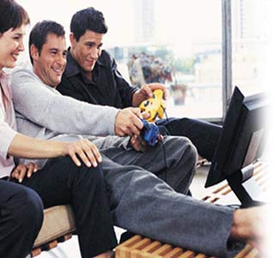
Jugar videojuegos
to play videogames

Slide 18
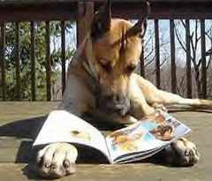
leer revistas
to read magazines

Slide 19
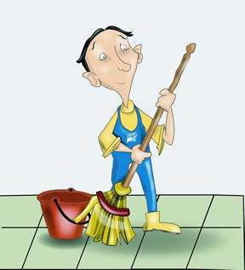
limpiar
to clean

Slide 20
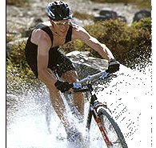
montar en bicicleta
to ride a bicycle

Slide 21
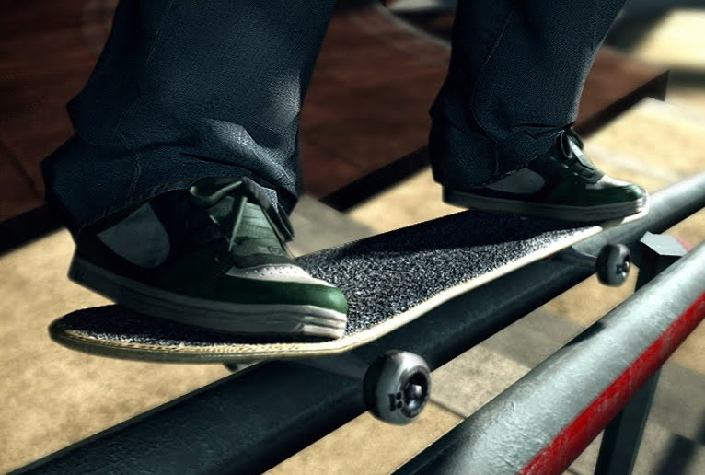
montar en monopatín
to skateboard

Slide 22
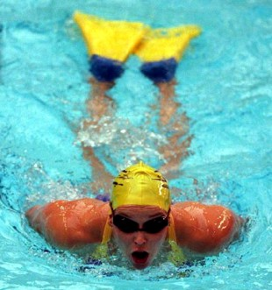
nadar
to swim

Slide 23
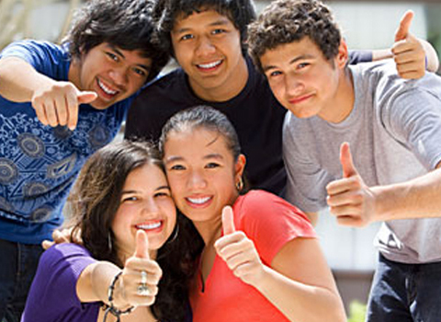
pasar tiempo con amigos
to spend time with friends

Slide 24
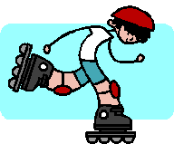
patinar
to skate

Slide 25
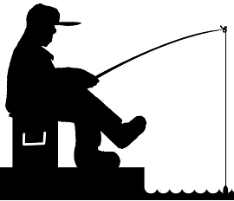
pescar
to go fishing

Slide 26
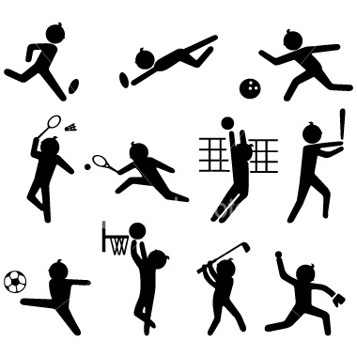
practicar deportes
to practice sports

Slide 27
tocar la guitarra/ el piano
to play the guitar/piano

Slide 28

trabajar
to work

Slide 29
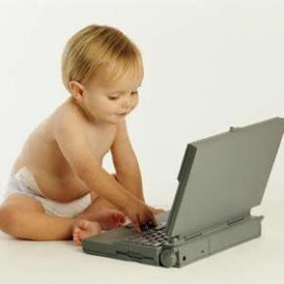
usar la computadora
to use the computer

Slide 30
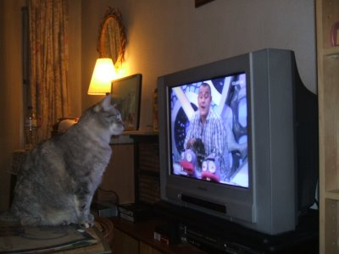
Ver/mirar la tele
to see/watch television

Slide 31
viajar
to travel

Slide 32
Infinitives
What are they?
They fit in three categories based on how they’re spelled. What are those categories?

Slide 33
To say what you like to do…

Slide 34
(A mí) me gusta ___.
I like ____.

Slide 35
(A mí) me gusta mas ___.
I like ___ more.

Slide 36
(A mí) me gusta mucho _.
I like ___ a lot.

Slide 37
A mí también.
Me too.

Slide 38
To say what you don’t like to do…

Slide 39
(A mí) no me gusta ___.
I don’t like ___.

Slide 40
(A mí) no me gusta __ nada.
I don’t like ___ at all.

Slide 41
A mí tampoco.
Me neither.
(I don’t like to either.)

Slide 42
To ask what others like to do…

Slide 43
¿Qué te gusta hacer?
What do you like to do?

Slide 44
¿Qué te gusta más?
What do you like more?

Slide 45
¿Te gusta __?
Do you like ___?

Slide 46
¿Y a ti?
And you?

Slide 47
Other words and expressions:

Slide 48
ni…ni
neither…nor
not…or

Slide 49
o
or

Slide 50
pues...
well...

Slide 51
sí
yes

Slide 52
también
also, too

Slide 53
y
and

Slide 54
tampoco
Either / neither

Slide 55
A PRACTICAR!
Do you like to dance?
Yes, and I like to talk, too.
I don’t like neither to study nor to write.
I don’t like to study, either!
Well, I like to study.
Do you like to ski or read?
I don’t like neither to ski nor to read!

Slide 56
A PRACTICAR!
What do you like more – to draw or to run?
I like to draw and to run!
I don’t like neither to draw nor to run.
Well, I like to run and I don’t like to draw.
I like to draw more.
I don’t like to run at all.
I like to draw a lot!

